Slide 1
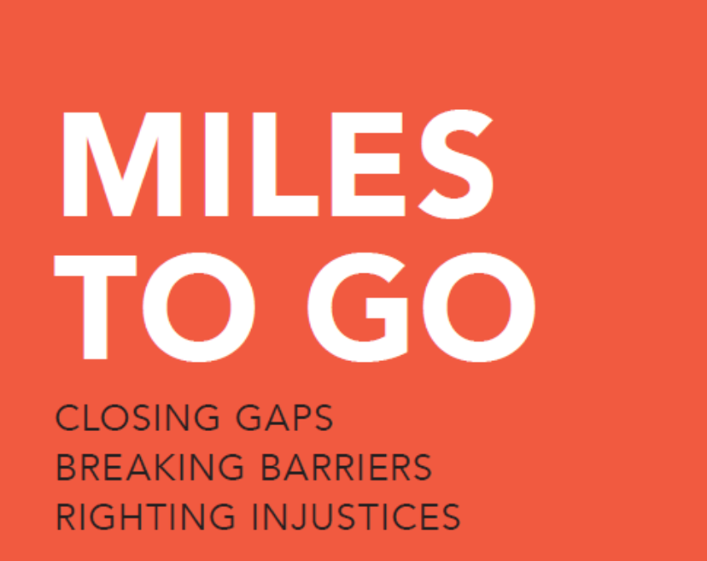
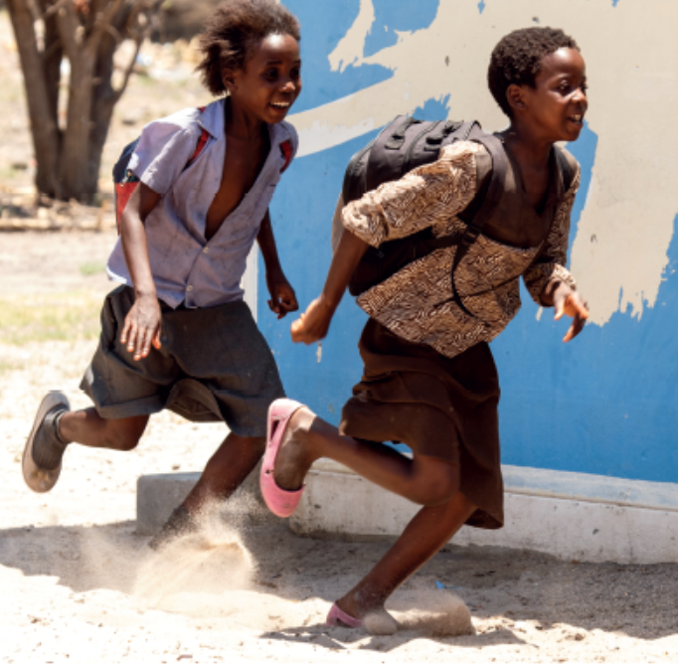

Slide 2
AIDS-related deaths the lowest this century
Number of AIDS-related deaths, global, 1990–2017 and 2020 target
3 000 000
2 500 000
Number of AIDS-related deaths
2 000 000
1 500 000
1 000 000
500 000
0
1990
1991
1992
1993
1994
1995
1996
1997
1998
1999
2000
2001
2002
2003
2004
2005
2006
2007
2008
2009
2010
2011
2012
2013
2014
2015
2016
2017
2018
2019
2020
AIDS-related deaths
Target
Source: UNAIDS 2018 estimates.

Slide 3
Little change in new HIV infections outside of sub-Saharan Africa
Number of new HIV infections, sub-Saharan Africa and regions outside sub-Saharan Africa, 1990–2017
3 500 000
3 000 000
Number of new HIV infections
2 500 000
2 000 000
1 500 000
1 000 000
500 000
0
1990
1991
1992
1993
1994
1995
1996
1997
1998
1999
2000
2001
2002
2003
2004
2005
2006
2007
2008
2009
2010
2011
2012
2013
2014
2015
2016
2017
Sub-Saharan Africa
Regions outside of sub-Saharan Africa
Source: UNAIDS 2018 estimates.

Slide 4
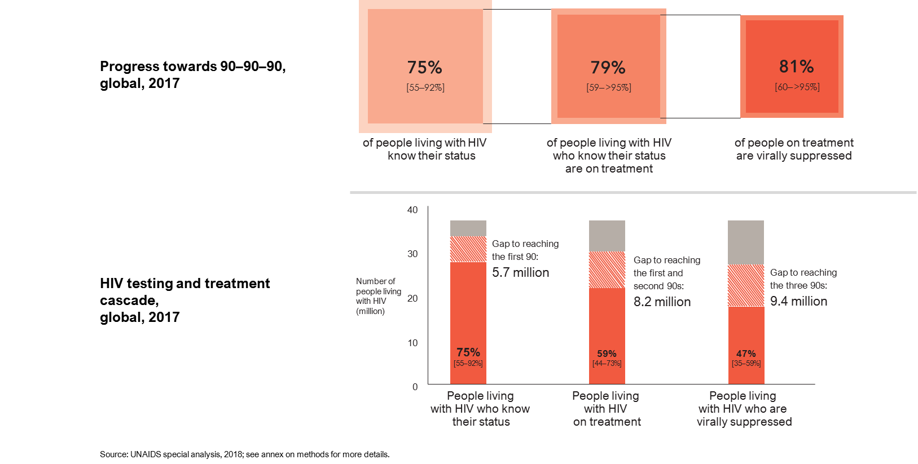
Remarkable progress on HIV testing and treatment

Slide 5
Remarkable progress on HIV testing and treatment

Slide 6
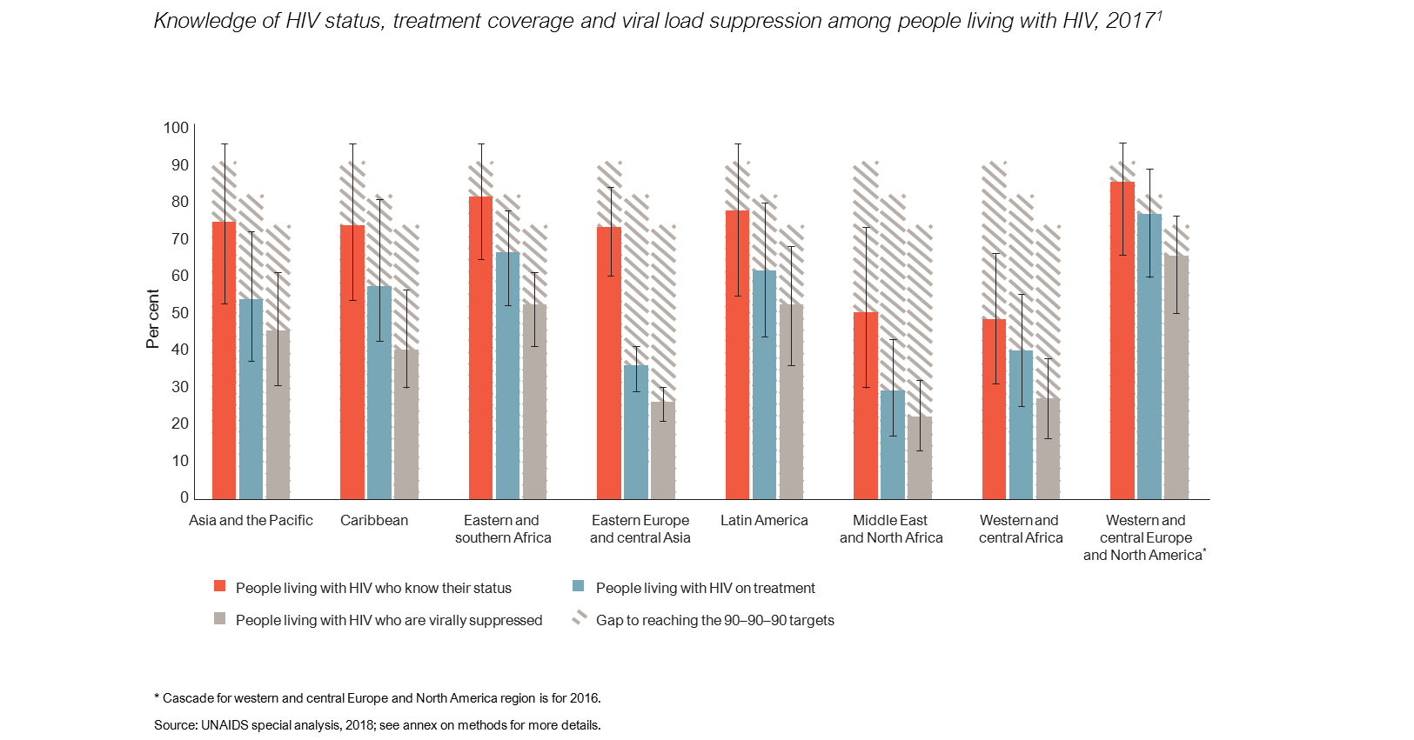
Progress varies by region

Slide 7
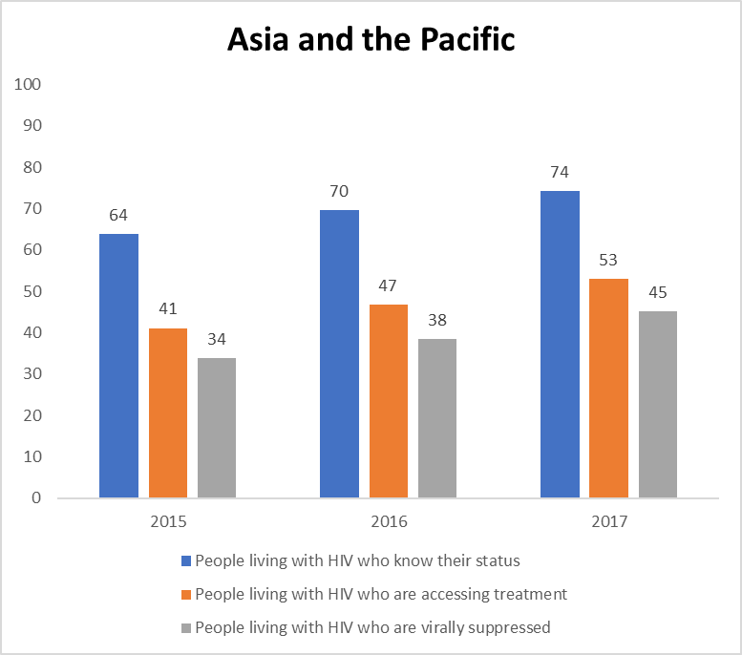
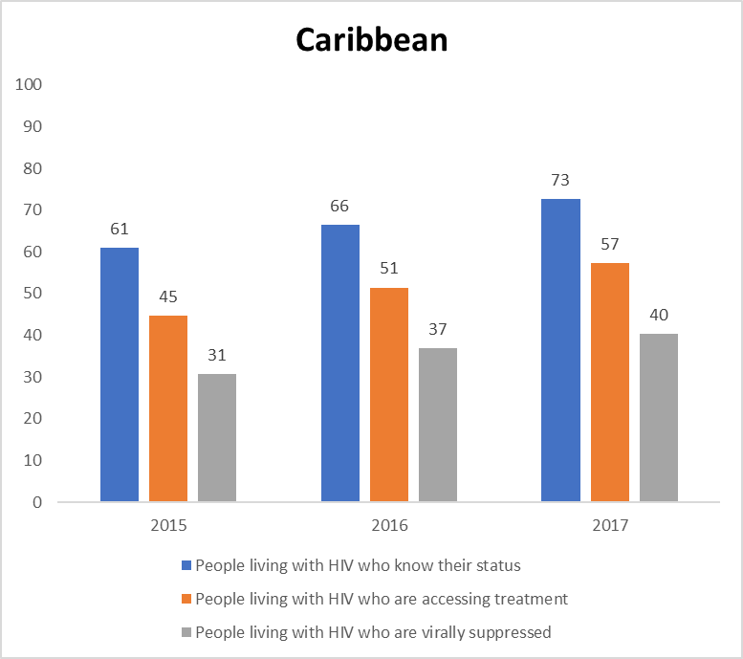
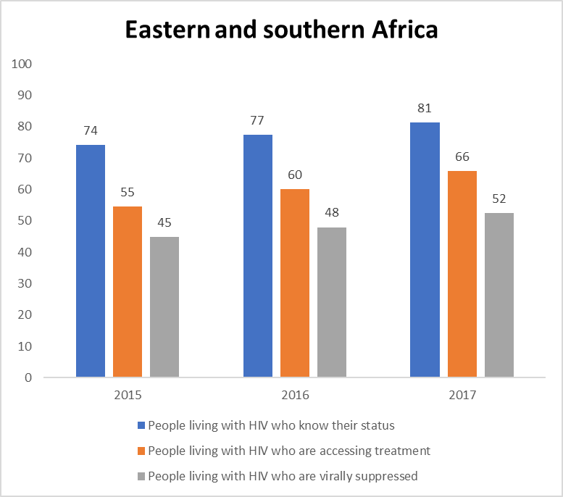
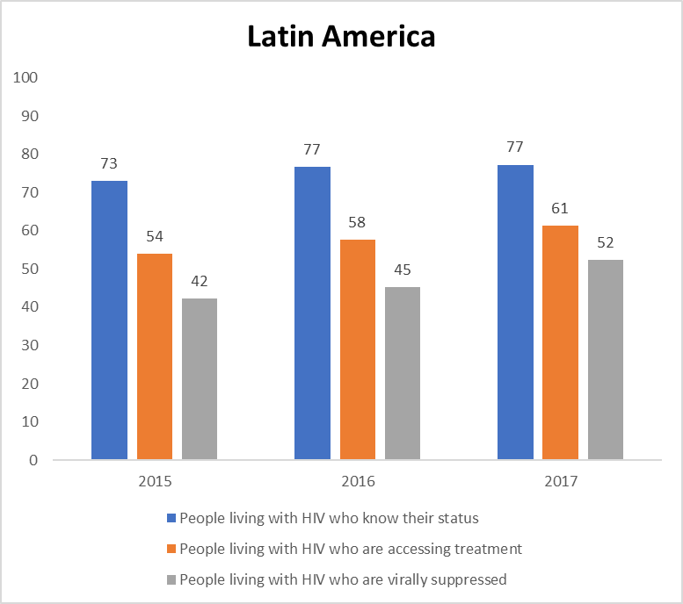
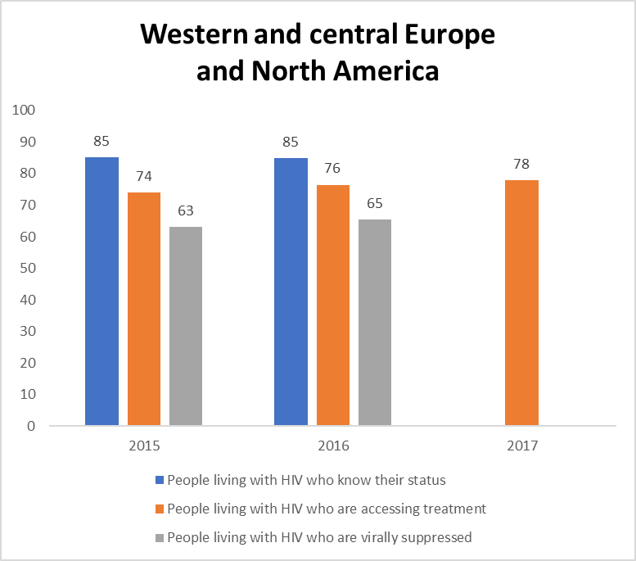
Progress towards 90-90-90, by region, 2015-2017

Slide 8
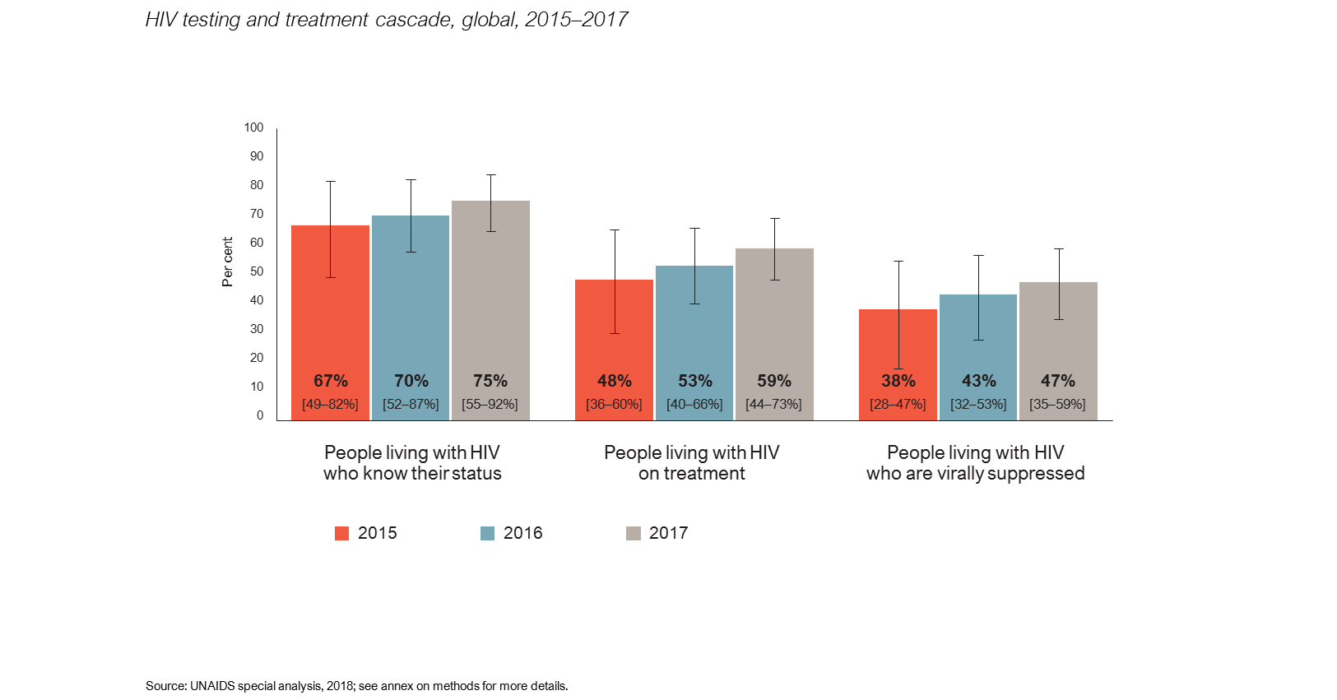
Moving towards global targets

Slide 9
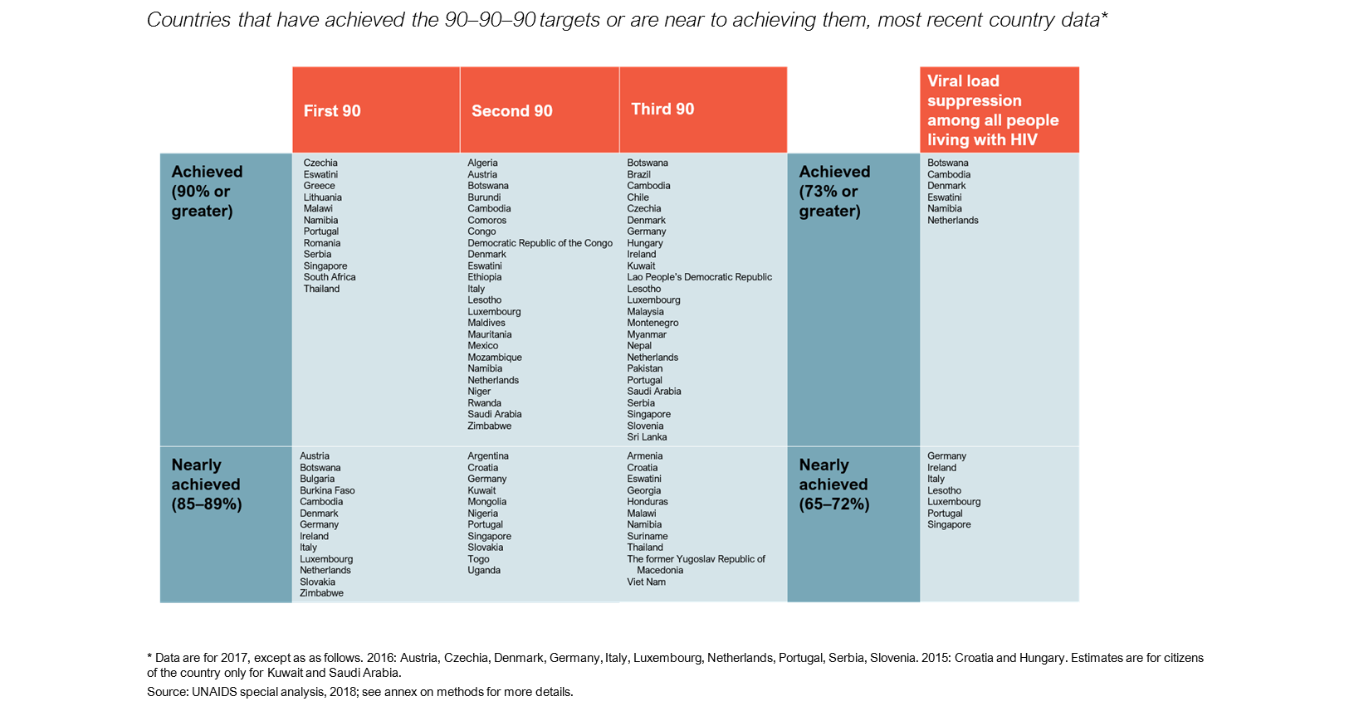
Country progress towards 90–90–90

Slide 10
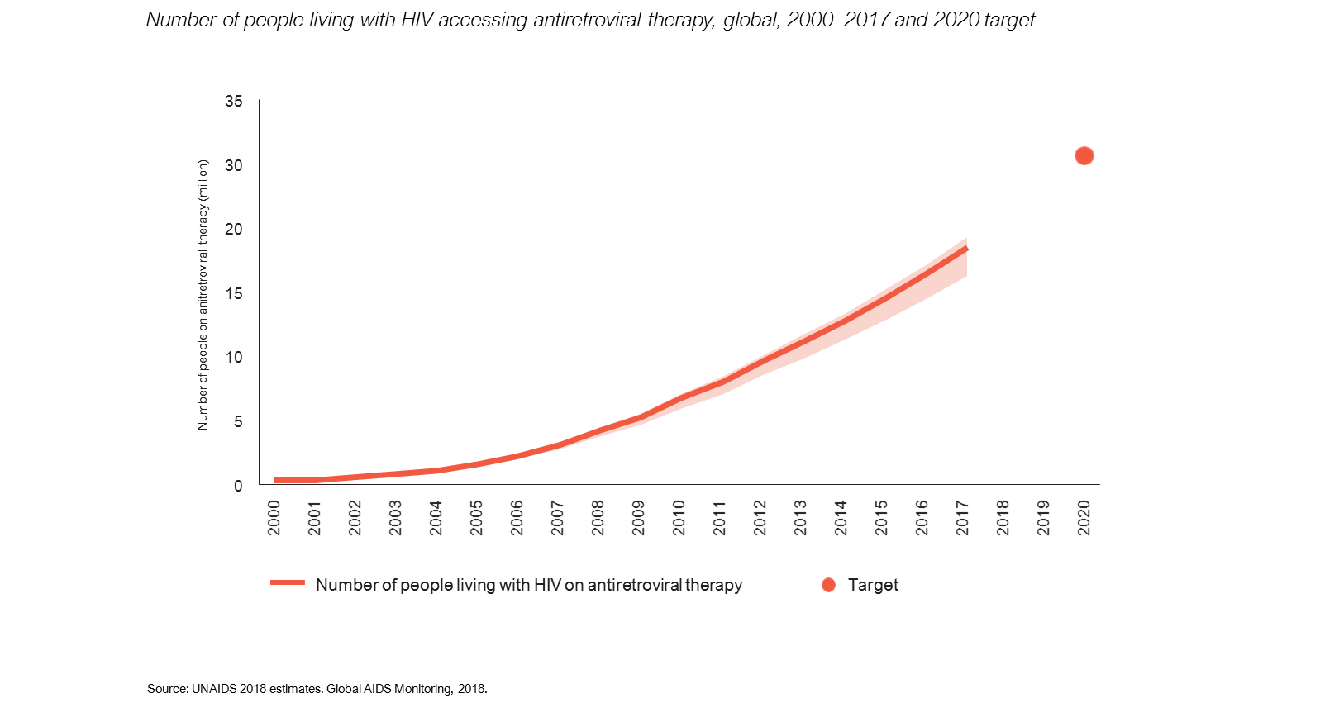
Moving towards global targets

Slide 11
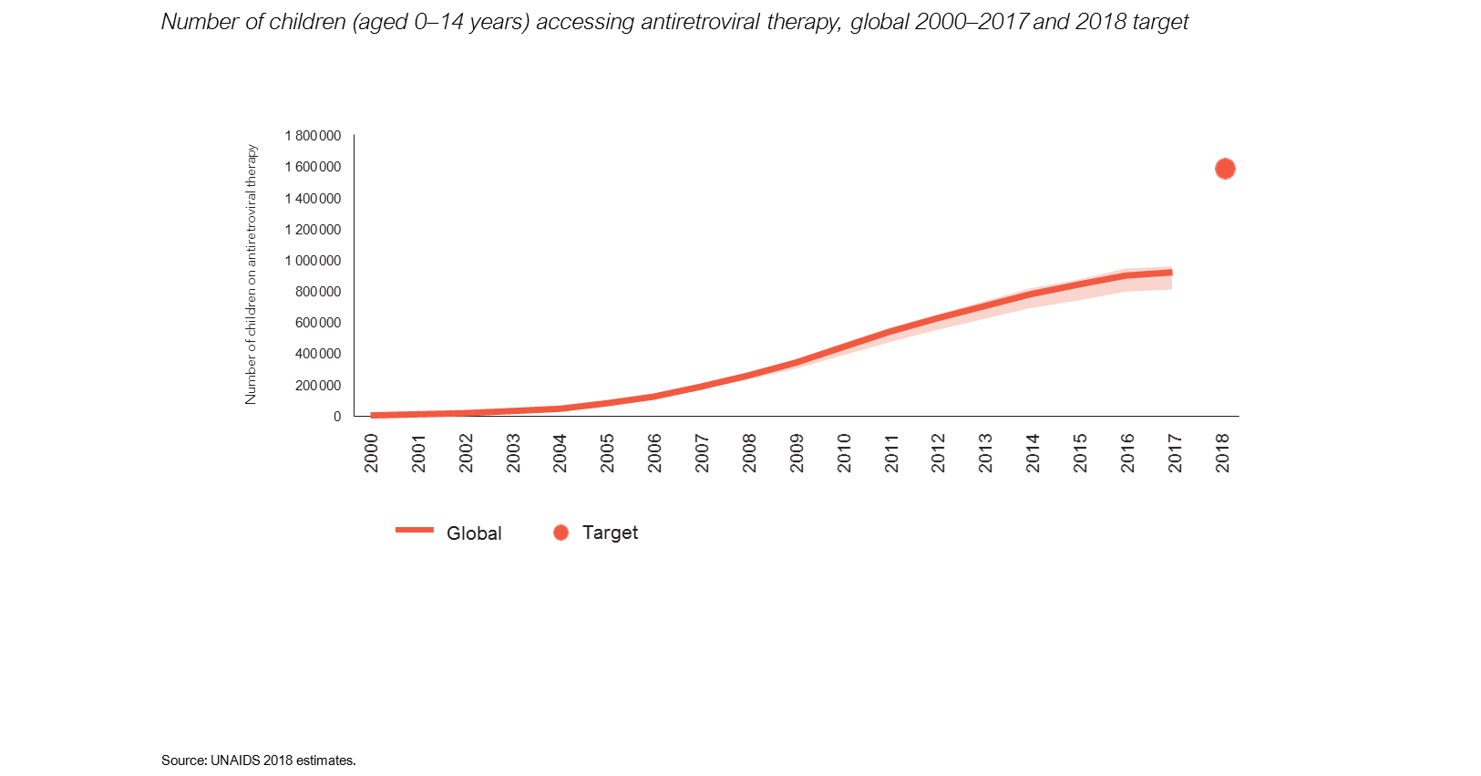
Moving towards global targets

Slide 12
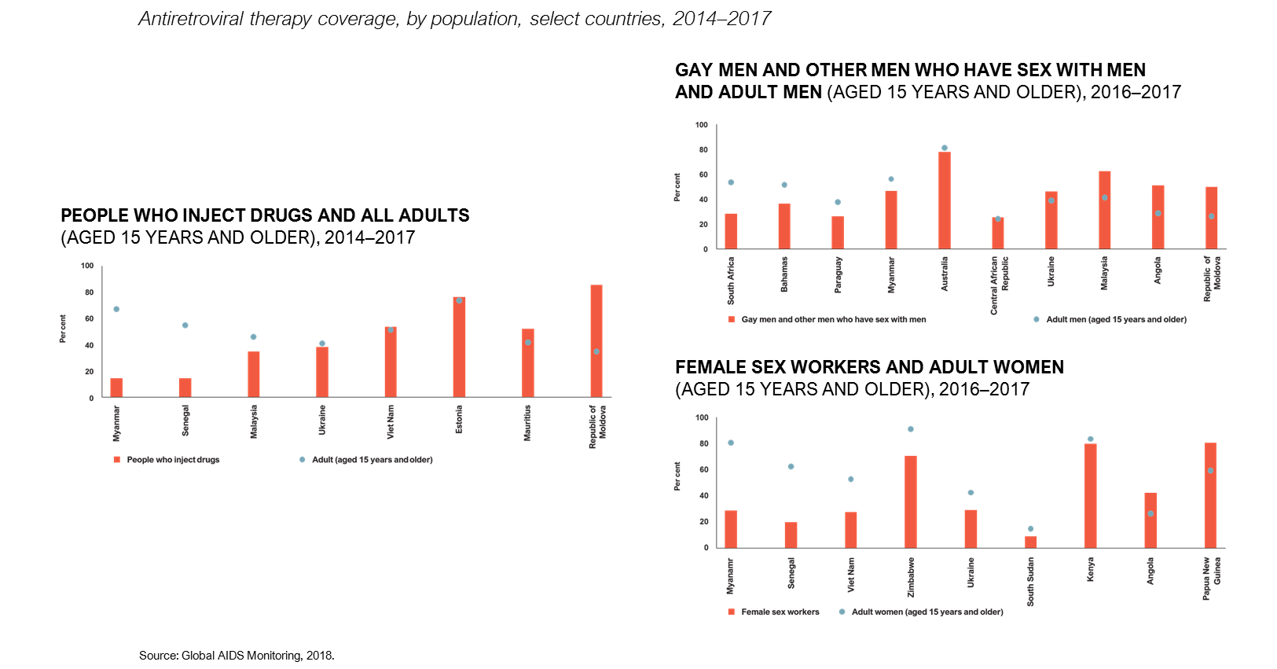
Treatment access often lower among key populations

Slide 13
Conclusion
Remarkable recent progress on HIV testing and treatment has been driven by strong and growing global commitment to achieve the 90–90–90 targets by 2020
Almost 60% of the 36.9 million people living with HIV were on treatment in 2017
To reach the 30 million target by 2020 there needs to be an annual increase of 2.8 million people (vs 2.3 in 2017)
Children, key populations, some countries have lower coverage

